Slide 1
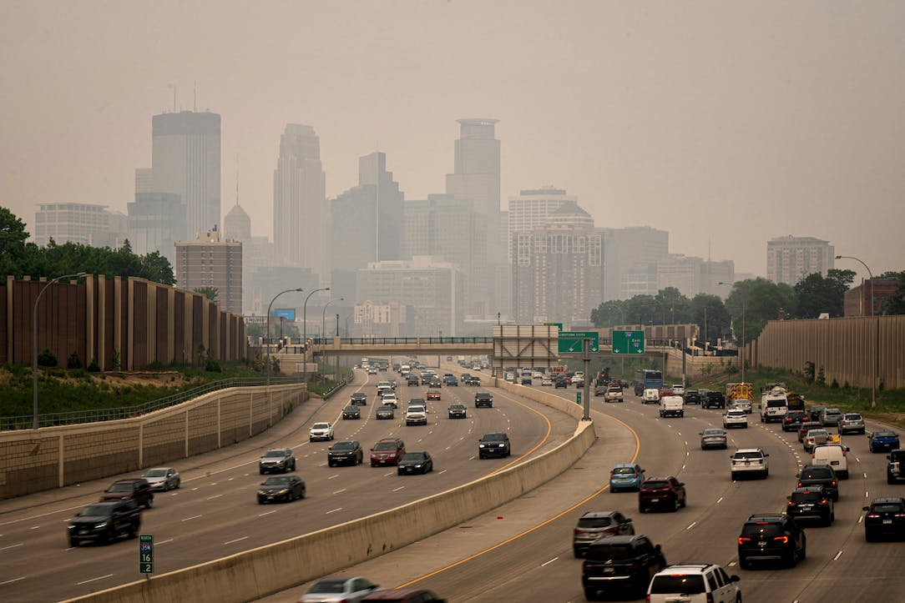
Spatial-temporal Analyzing of Air Quality in Twin Cities Metropolitan Area
ZAIN UL ABDIN SIYAL
GIS 8990: Research Problems in GIS

Slide 2

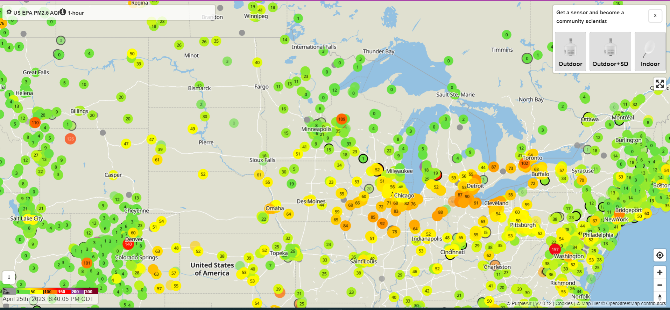
DATASET Links
Minneapolis Boundary Link here
Future Land Use 2040 Link here
Road Centerline MN Link here
AADT MN Link here
EPA Smart Location Mapping Link here
Air Quality data PurpleAir
More than 100 sensors and hourly reading average for 1 week.
Analyzing the data to determine the levels of PM2.5 in the areas surrounding the power plants.
PM2.5 Concentration Ranges
General Guideline | Concentration
Good | 0-12 µg/m³
Moderate | 12.1-35.4 µg/m³
Unhealthy for sensitive groups | 35.5-55.4 µg/m³
Unhealthy | 55.5-150.4 µg/m³
Very unhealthy | 150.5-250.4 µg/m³
Hazardous | 250.5 µg/m³ or higher

Slide 3
DATASET Links
Minneapolis Boundary Link here

Slide 4
PROBLEM STATEMENT
Air pollution, especially through PM2.5 in Twin Cities metropolitan area is a significant environmental and public health concern and has been linked to a range of health problems.
How does air quality vary spatially and temporally within the Minneapolis metropolitan areas, considering factors such as seasons, days of the week, and hours of the day?
What are the relationships between human mobility patterns, weather conditions, population distribution, employment density, land use, and traffic patterns, and air quality in the absence of high-resolution temporal air quality data?
What spatial-temporal patterns and trends exist in the air quality of the Twin Cities metro area, and how can this information be used to inform air quality management and policies?

Slide 5
Expected Routes
Examine the correlation between air quality measurements and mobility patterns. Consider utilizing mobility data sources, such as Annual Average Daily Traffic data, public transportation records, etc.
For certain seasons or events (e.g., concert, festivals, sports events), study the impact of increased human mobility on local air quality.
Use time-series analysis techniques to uncover trends, seasonality, and anomalies in air quality data. This can include methods like autoregressive integrated moving average (ARIMA) modeling, seasonal decomposition, and trend analysis.

Slide 6

Purple Air Data issues:
Through ETL:
3088, 5582, 11134, 21179, 43305, 54907, 61239, 77405, 85113, 99807, 101525, 108364, 110979, 113486, 128195, 142718, 142720, 142726, 142724, 142734, 142732, 142736, 142742, 142744, 142750, 142748, 142774, 142928, 142932, 143214, 143216, 143226, 143224, 143242, 143240, 143246, 143248, 143284, 143634, 143636, 143648, 143656, 143660, 143666, 143668, 143916, 143942, 145202, 145204, 145242, 145250, 145262, 145454, 145470, 145498, 145506, 145604, 157845, 157861, 157871, 157877, 157935, 161401, 166459, 168327, 174451, 174855, 176569, 182801, 183325, 186901, 188539, 193171, 193207, 194635, 196233, 198941
43305, 11134, 157935, 142774, 145250, 143246, 157837, 142852, 145616, 142730, 142718, 142744, 142752, 143636, 145610, 142726, 143648, 157787, 143238, 143222, 145242, 142756, 54907, 143666, 143224, 157747, 145202, 145204, 143242, 157877, 143214, 145470, 46215, 143226, 142732, 145234, 157845, 157871, 157861, 113486, 3088, 145454, 156605, 174451, 157757, 142728, 142720, 143916, 116413, 142748, 21179, 142736, 143216, 17189

Slide 7
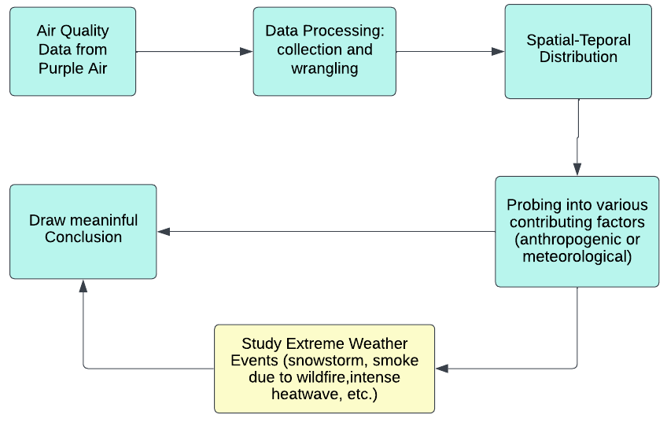
METHODOLOGY
Study Workflow Summary:

Slide 8
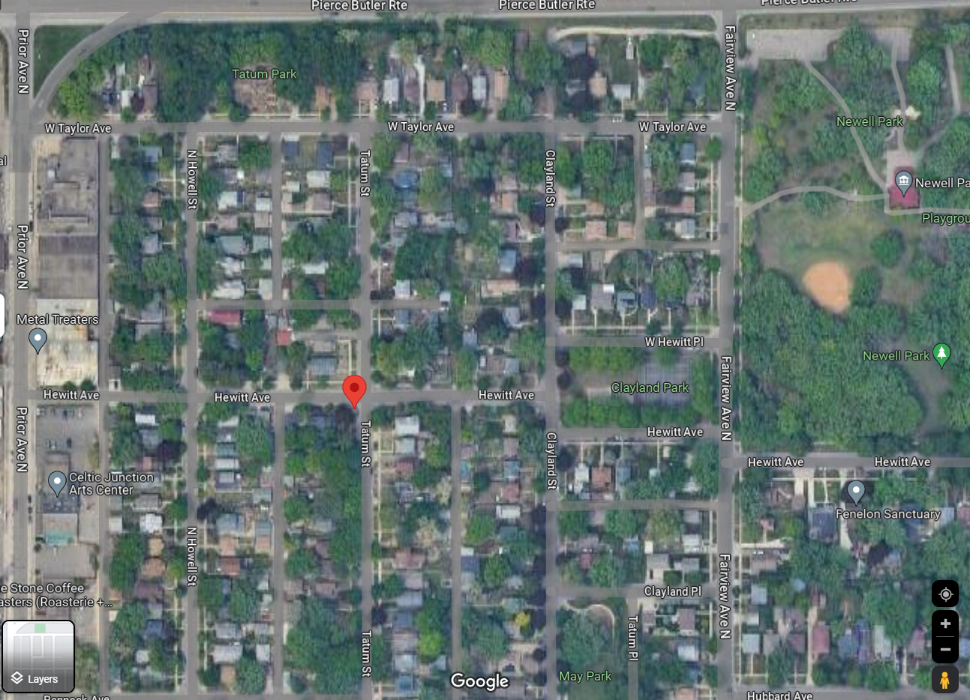
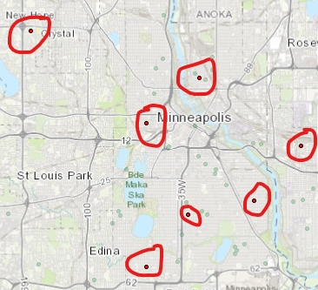
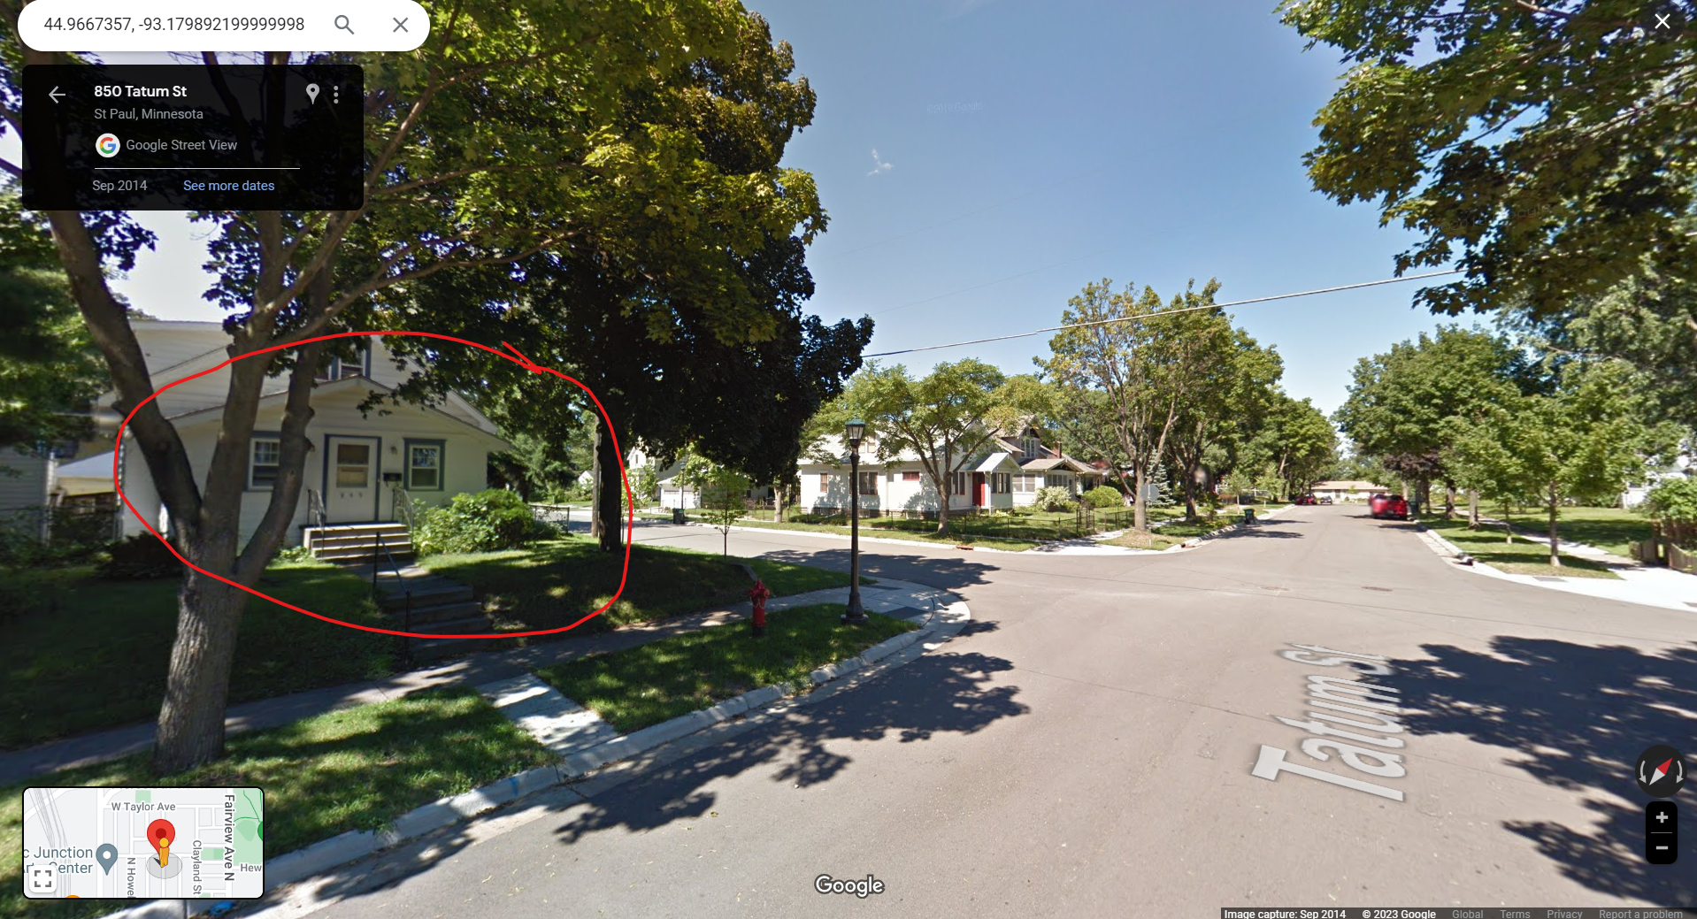
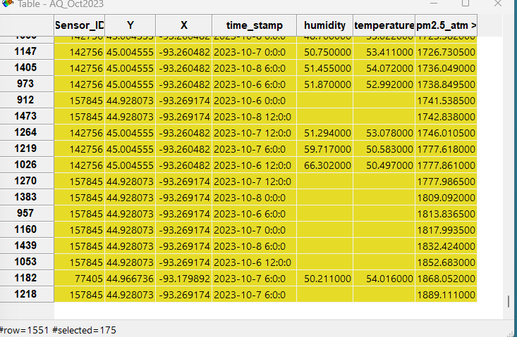
OCT 2023

Slide 9
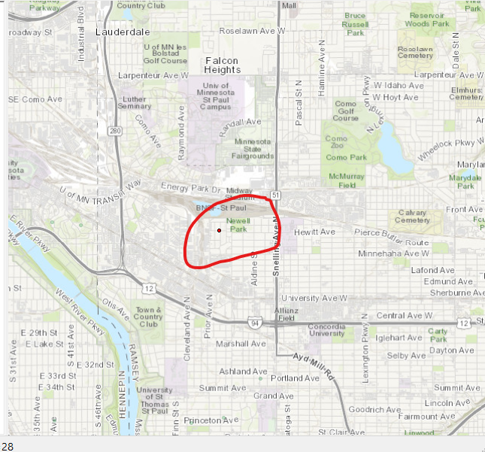
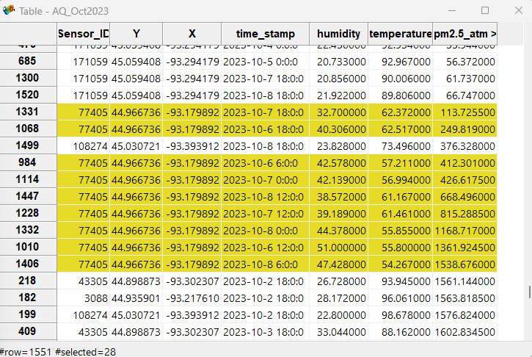
77405

Slide 10
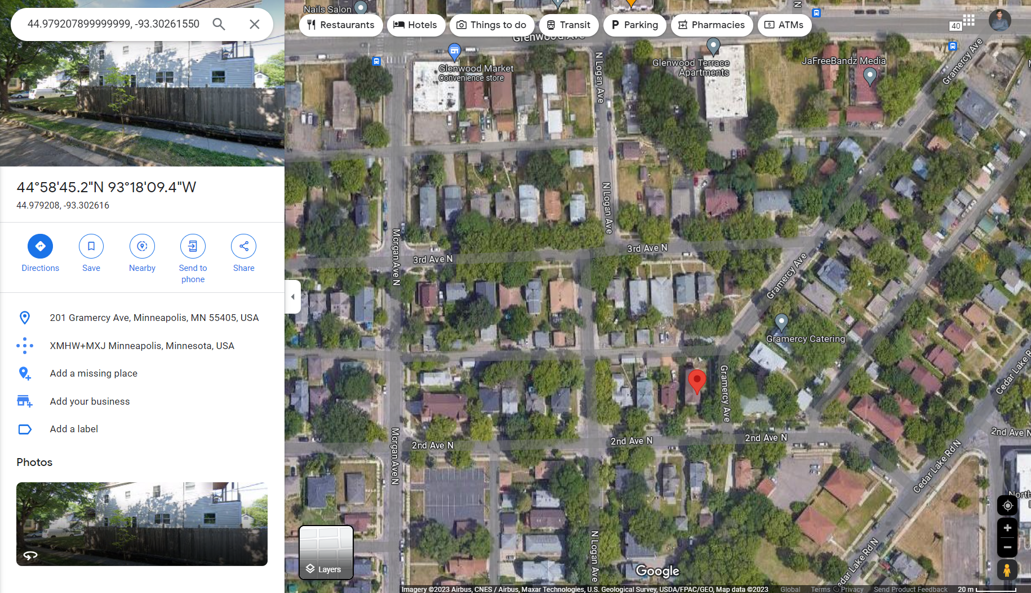
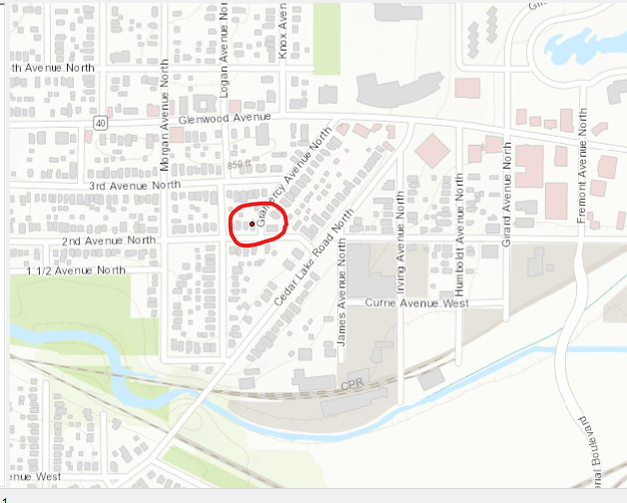
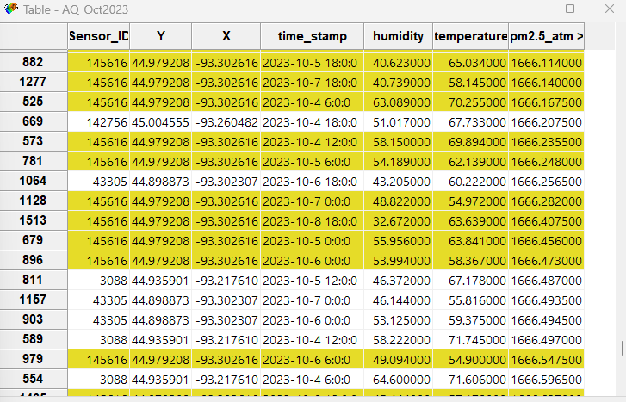
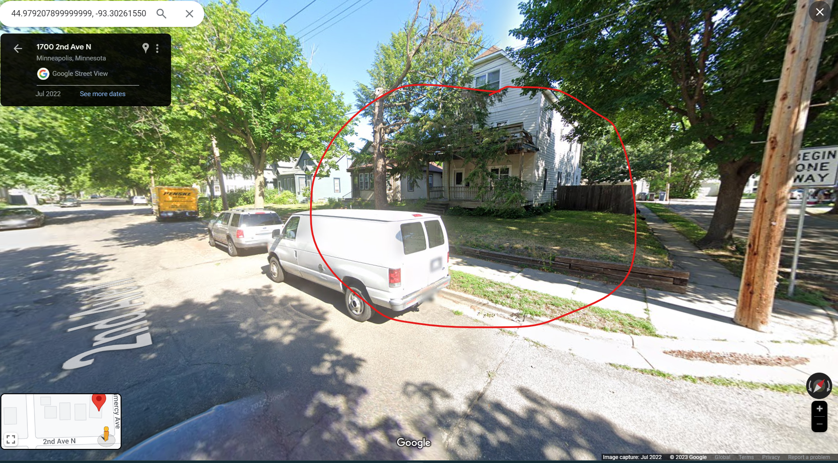
145616

Slide 11
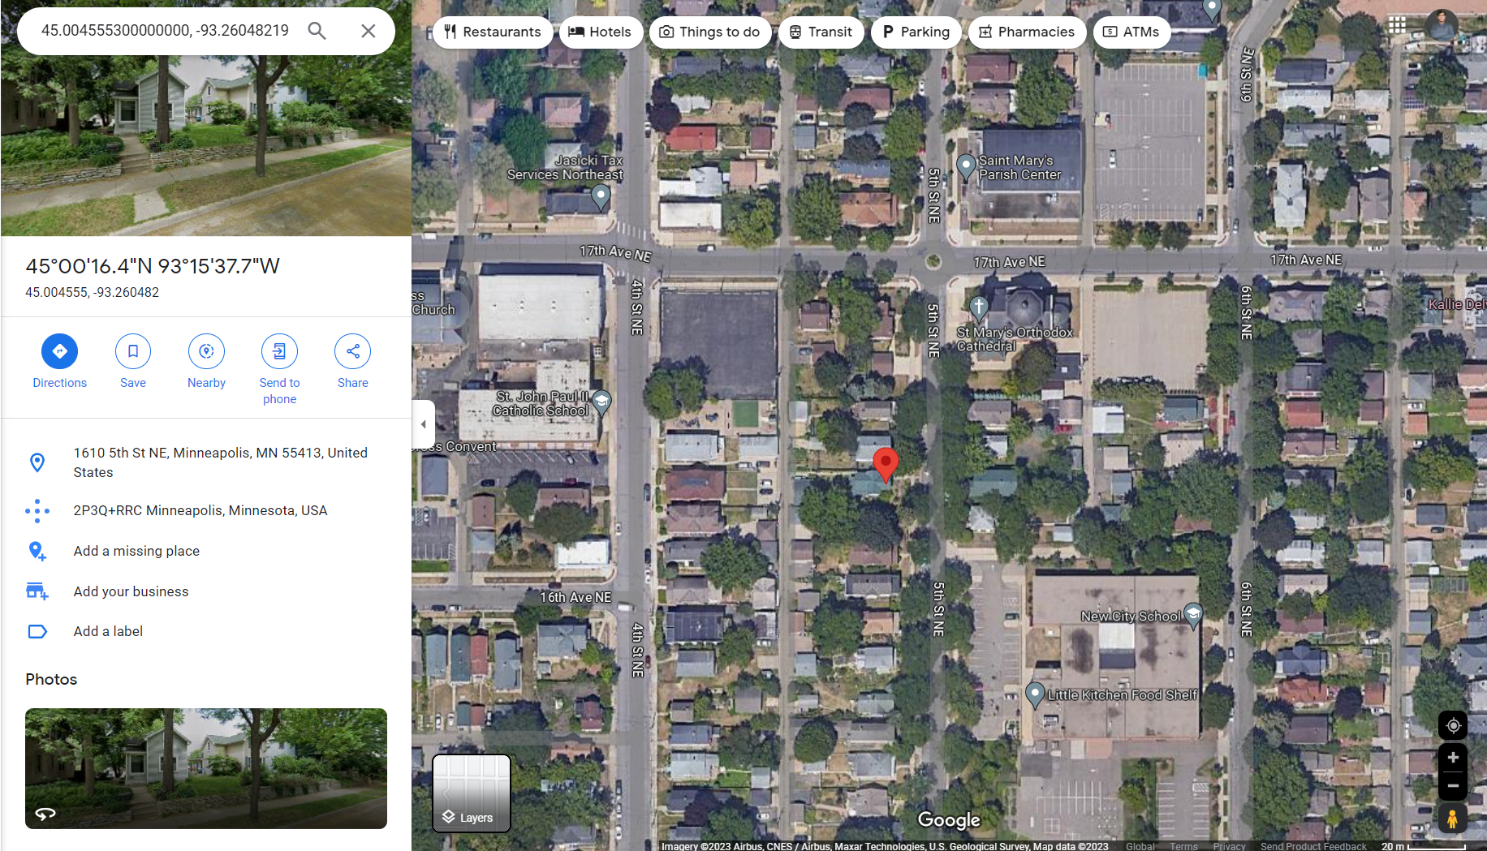
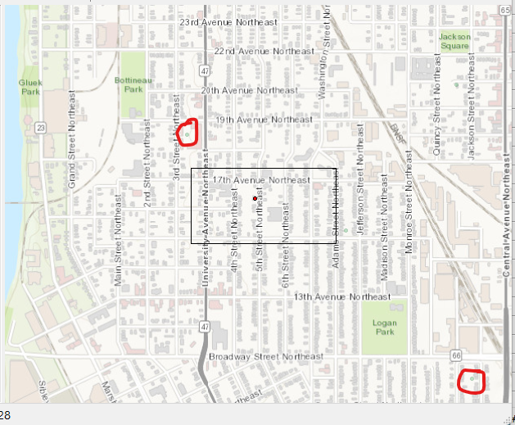
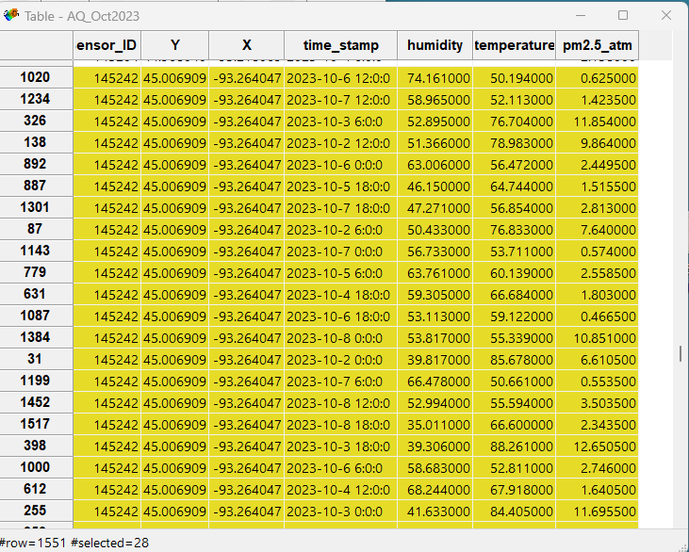
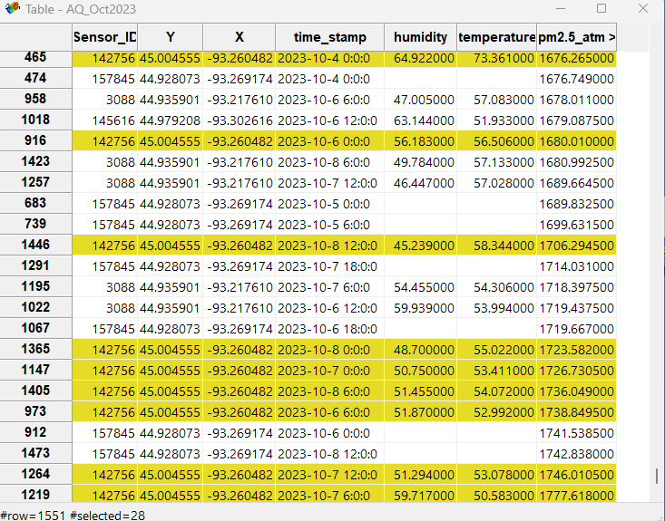
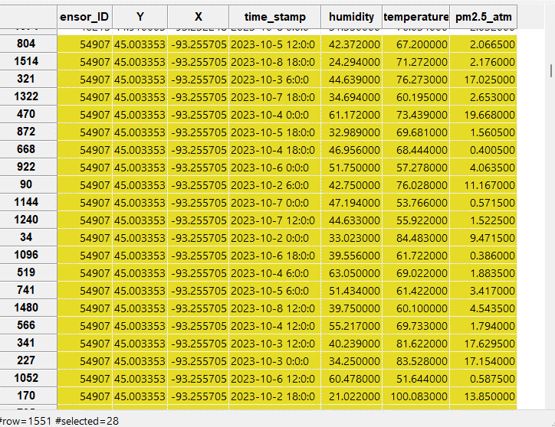
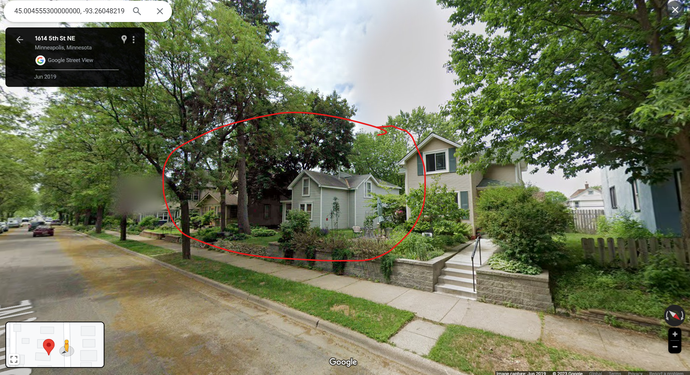
3 Sensors in Close Proximity
142756

Slide 12
Cleaning the Data (ETL)
Season | Time | Display the sensors with average pm2.5_atm greater than 500 or any readings greater than 1004
Winter | January 2023 | [NULL]
Spring | April 2023 | [NULL]
Summer | July 2023 | [3088, 157871] [3088, 77405, 145242, 157871] – 2nd week
Fall | Oct 2023 | [3088, 43305, 77405, 157845]

Slide 13
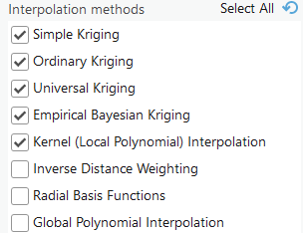
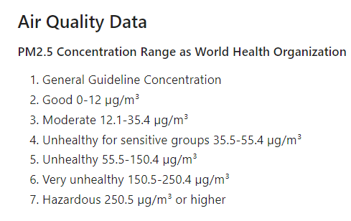
Spatial Interpolation Techniques
Inverse Distance Weighting (IDW)
Kriging
Spline Interpolation
Natural Neighbour

Slide 14
Useful Resources
Esri Courses
Ruptures package (anomalies)
Space Time Cube (https://pro.arcgis.com/en/pro-app/latest/tool-reference/space-time-pattern-mining/emerginghotspots.htm)
Esri Course (https://www.esri.com/training/catalog/5e14dd09e552ed469f09c1c6/identifying-clusters-using-arcgis/)
3 tools to do time series forecasting in ArcGIS Pro
Curve Fit Forecast (simplest)
Exponential Forecast
Forrest-based Forecast

Slide 15
Spatial-Temporal Analytical methods
Space-Time Cube Analysis
Space-Time Regression
Spatiotemporal Data Mining

Slide 16
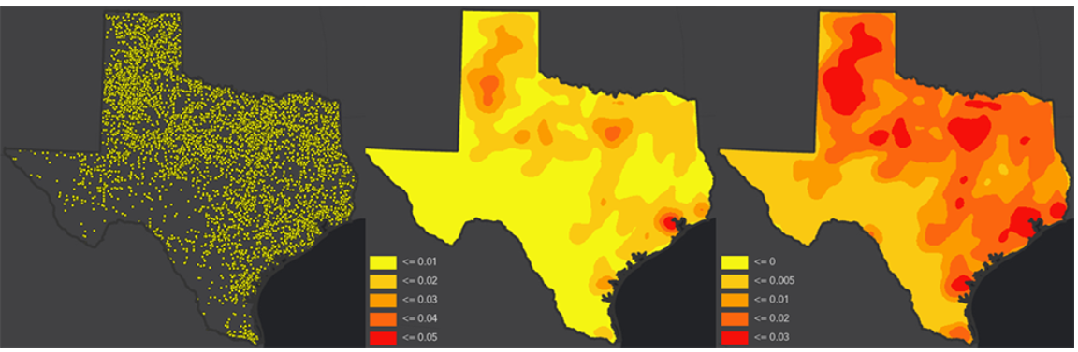
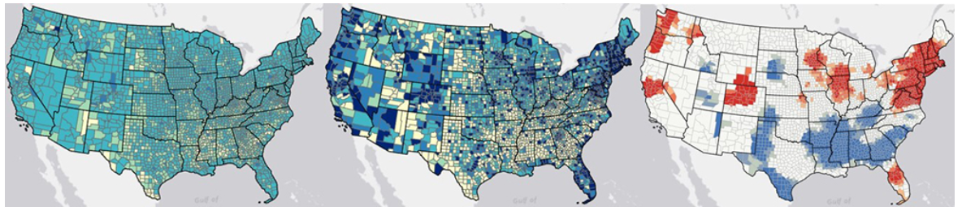
Consider the subjectivity of maps
Maps are used to visualize data, detect spatial patterns, and make decisions.
The interpretation of a map, however, can be subjective.
Your data's geometry and the symbology that you use to display the data can affect how your maps are interpreted and the stories that they tell.
Statistical Cluster Analysis
Statistical cluster analysis can help you minimize subjectivity in your maps.
It uses mathematics and inferential statistics to identify spatial patterns in your data and determine whether these patterns are meaningful or are the result of random chance.
The resulting map illustrates statistically significant patterns in your data.
Your interpretation of the map is based on the underlying data and statistics, not on subjective visualization.
These maps illustrate the same social media usage data for counties in the contiguous United States. The first two maps use different classification methods to illustrate patterns in the data. The third map uses statistical cluster analysis. This map is based on statistics, which will help you determine whether the patterns that you see are meaningful.
Notes:
Centers for Disease Control and Prevention
0 (least vulnerable) to 1 (most vulnerable)

Slide 17
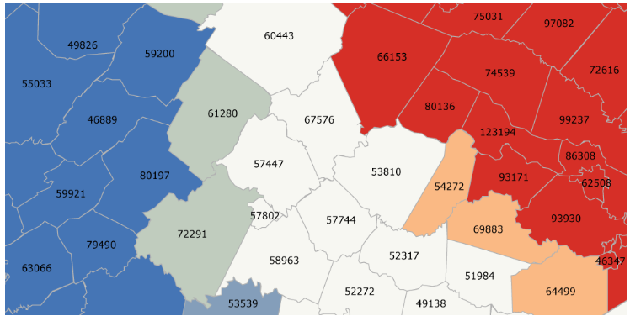
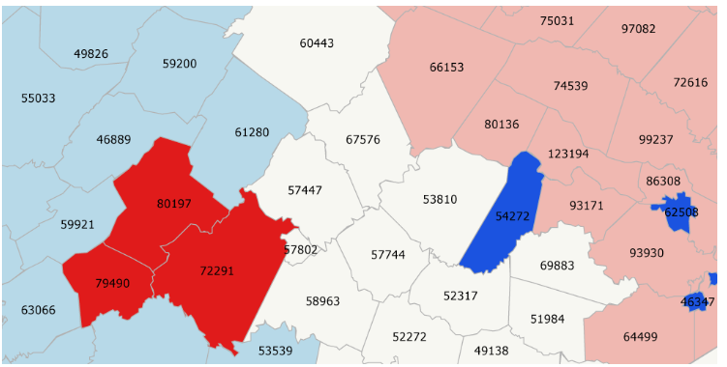
Statistical Cluster Analysis
ArcGIS provides Statistical Cluster Analysis can help minimize subjectivity in map interpretation.
It also determines whether the data's spatial patterns are the result of random chance.
Two Tools:
Hot Spot Analysis
Cluster And Outlier Analysis
Hot Spot Analysis tools use the Getis-Ord Gi* statistic to identify spatial clusters of statistically significant clusters of high values (hot spots) and low values (cold spots).
Cluster and Outlier Analysis tools use the Anselin Local Moran's I statistic to identify statistically significant hot spots, cold spots, and spatial outliers. The spatial outliers are significantly dissimilar from their neighboring features.
The red features (hot spots) belong to statistically significant clusters of features with high median household income. Blue features (cold spots) belong to statistically significant clusters of features with low median household income.
The bright red features and bright blue features are spatial outliers with median household income that is significantly higher (red) or lower (blue) than their neighboring features. The light red and light blue features represent clusters of features that all have significantly high (light red) or low (light blue) median household income.
Notes:
Yellow color: values more or less the same

Slide 18
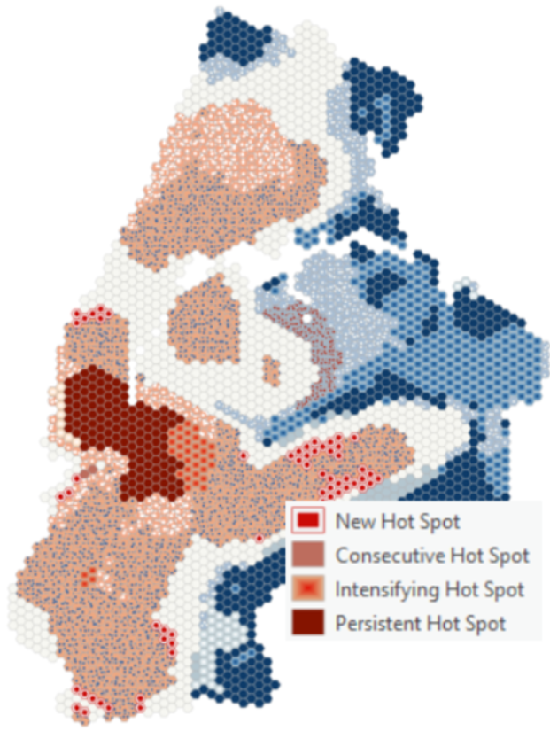
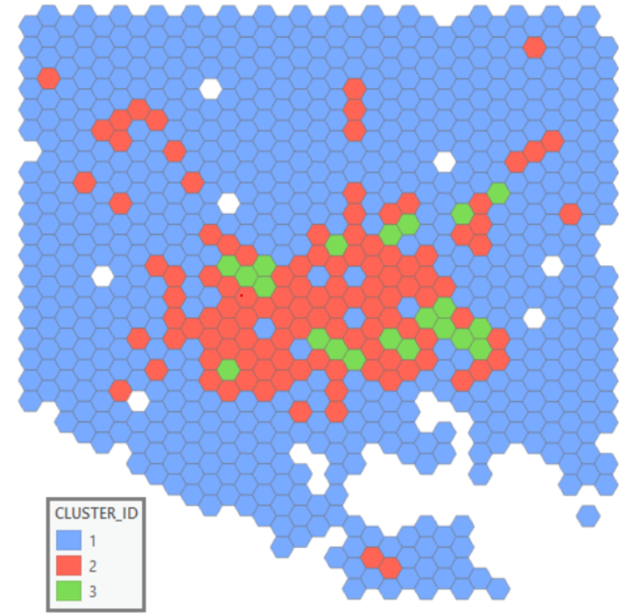
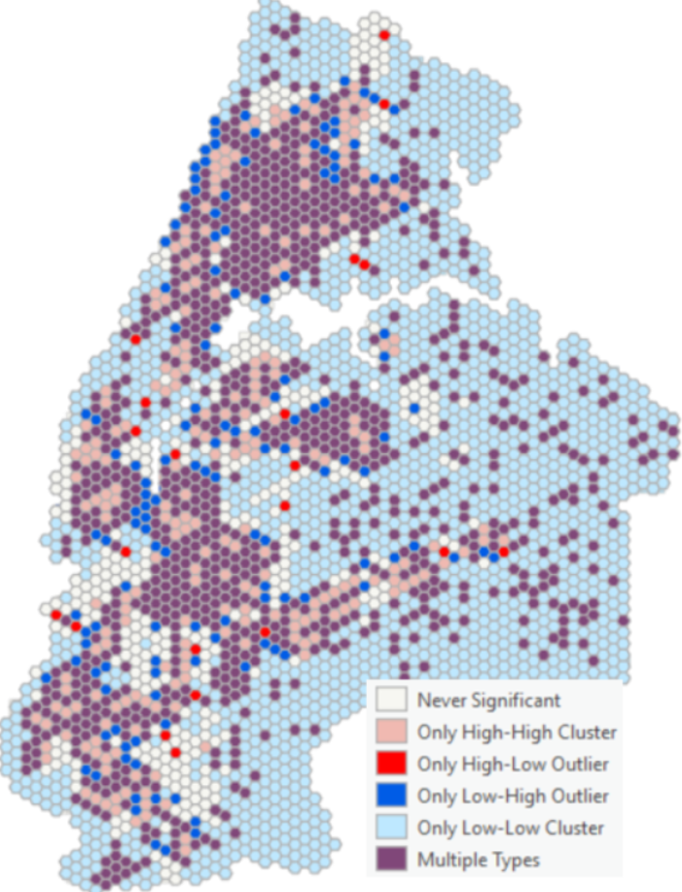
Space-Time Analysis Tool Capabilities
Emerging Hot Spot Analysis
Identifies trends in the clustering of point densities (counts) or values in a space-time cube
Can identify new, intensifying, sporadic, or diminishing hot or cold spots.
Time Series Clustering
Partitions a collection of time series, stored in a space-time cube, based on the similarity of time series characteristics
Local Outlier Analysis
Identifies statistically significant clusters and outliers in the context of both space and time
Visualize Space-Time Cube In 2D/3D
Notes:
Yellow color: values more or less the same

Slide 19
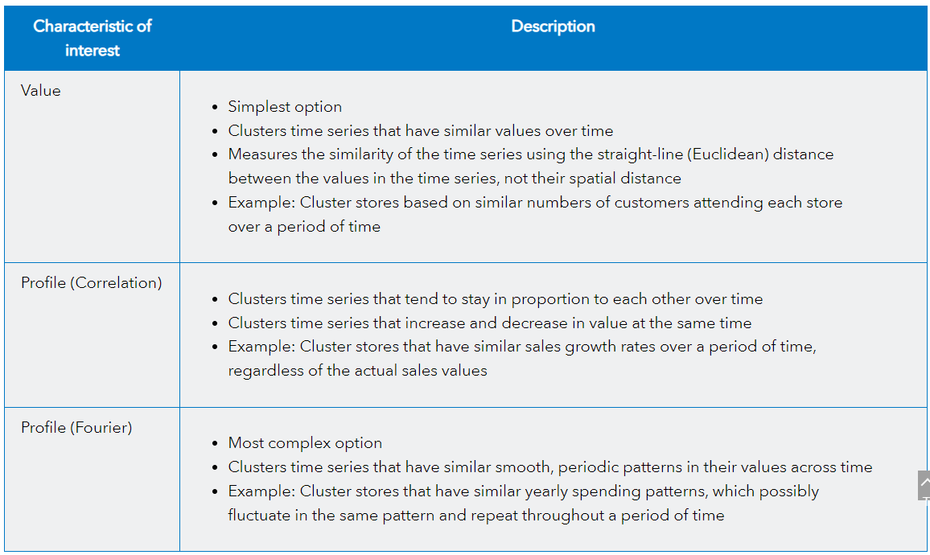
Space-Time Analysis Tool Capabilities
Time Series Clustering
Partitions a collection of time series, stored in a space-time cube, based on the similarity of time series characteristics
Notes:
Yellow color: values more or less the same

Slide 20
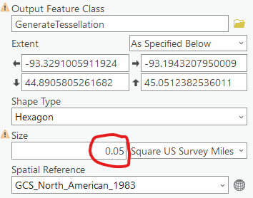
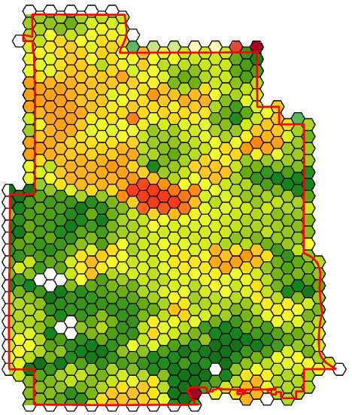
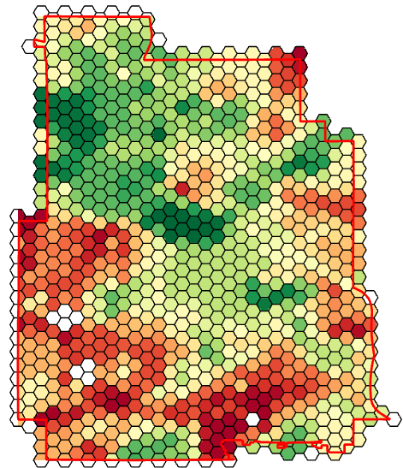
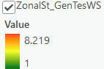
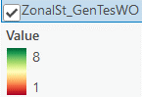
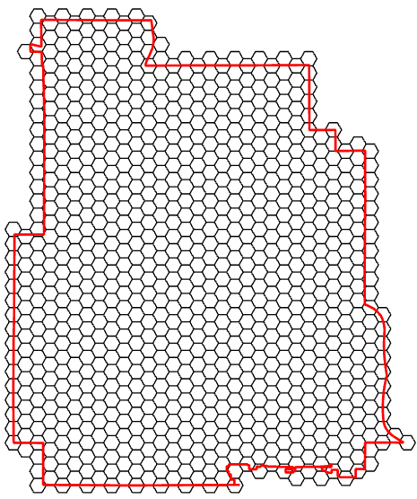
Hexagons and Zonal Statistics:
Notes:
Yellow color: values more or less the same

Slide 21
Notebook Structure
Air Quality Data Cleaning and Compiling
Boxplot
Static and interactive
Using Ruptures package to detect Anomalies in PM2.5
Static and interactive
To get Sensor IDs with an average pm2.5_atm greater than 500.
Animated Scatter Plot
Map in the background and timestamp

Slide 22
Useful Resources
Esri Courses
Raptures package (anomalies)
Space Time Cube (https://pro.arcgis.com/en/pro-app/latest/tool-reference/space-time-pattern-mining/emerginghotspots.htm)
Esri Course (https://www.esri.com/training/catalog/5e14dd09e552ed469f09c1c6/identifying-clusters-using-arcgis/)
3 tools to do time series forecasting in ArcGIS Pro
Curve Fit Forecast (simplest)
Exponential Forecast
Forrest-based Forecast

Slide 23
REFERENCES
World Health Organization. (2021, November 15). Ambient (Outdoor) Air Pollution. Retrieved from https://www.who.int/news-room/fact-sheets/detail/ambient-(outdoor)-air-quality-and-health.
Chen, Z., Chen, D., Zhao, C., Kwan, M. P., Cai, J., Zhuang, Y., ... & Xu, B. (2020). Influence of meteorological conditions on PM2. 5 concentrations across China: A review of methodology and mechanism. Environment international, 139, 105558.
Guan, W. J., Zheng, X. Y., Chung, K. F., & Zhong, N. S. (2016). Impact of air pollution on the burden of chronic respiratory diseases in China: time for urgent action. The Lancet, 388(10054), 1939-1951.
Guo, L. C., Zhang, Y., Lin, H., Zeng, W., Liu, T., Xiao, J., ... & Ma, W. (2016). The washout effects of rainfall on atmospheric particulate pollution in two Chinese cities. Environmental pollution, 215, 195-202.
Duhanyan, N., & Roustan, Y. (2011). Below-cloud scavenging by rain of atmospheric gases and particulates. Atmospheric Environment, 45(39), 7201-7217.
Feng, X., & Wang, S. (2012). Influence of different weather events on concentrations of particulate matter with different sizes in Lanzhou, China. Journal of Environmental Sciences, 24(4), 665-674. (Link)
Jing, Z., Liu, P., Wang, T., Song, H., Lee, J., Xu, T., & Xing, Y. (2020). Effects of meteorological factors and anthropogenic precursors on PM2. 5 concentrations in cities in China. Sustainability, 12(9), 3550. (Link)
Sun, R., Zhou, Y., Wu, J., & Gong, Z. (2019). Influencing factors of PM2. 5 pollution: Disaster points of meteorological factors. International Journal of Environmental Research and Public Health, 16(20), 3891. (Link)
Guo, X., Shi, J., Ren, D., Ren, J., & Liu, Q. (2017). Correlations between air pollutant emission, logistic services, GDP, and urban population growth from vector autoregressive modeling: a case study of Beijing. Natural Hazards, 87, 885-897. (Link)
Chen, D., Liu, X., Lang, J., Zhou, Y., Wei, L., Wang, X., & Guo, X. (2017). Estimating the contribution of regional transport to PM2. 5 air pollution in a rural area on the North China Plain. Science of the Total Environment, 583, 280-291. (Link)
Wang, S., Liu, X., Yang, X., Zou, B., & Wang, J. (2018). Spatial variations of PM2. 5 in Chinese cities for the joint impacts of human activities and natural conditions: A global and local regression perspective. Journal of cleaner production, 203, 143-152. (Link).

Slide 24
QUESTIONS?

